Slide 1


Slide 2
Managing Diversity
Learning Outcome
Define workplace diversity and explain why managing it is so important
Describe the changing workplaces in the United States and around the world
Explain the different types of diversity found in workplaces
Discuss the challenges managers face in managing diversity
Describe various workplace diversity management initiatives

Slide 3
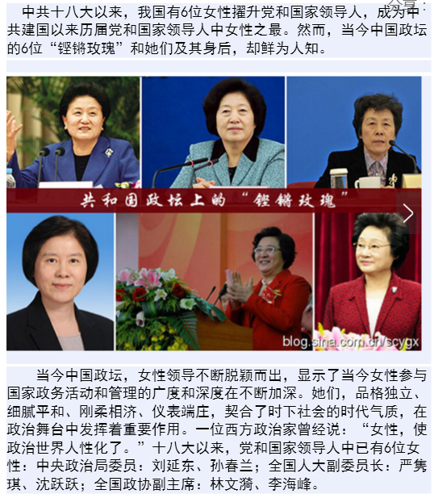
中国六大副国级女性领导人

Slide 4
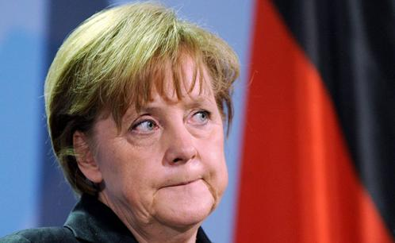
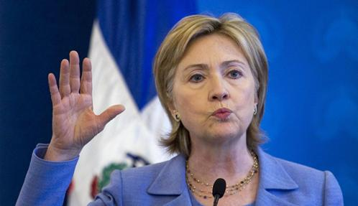
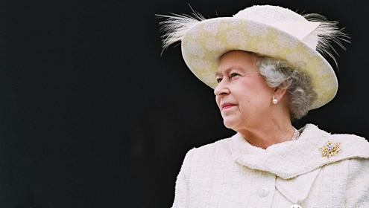
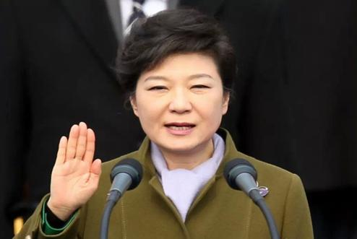
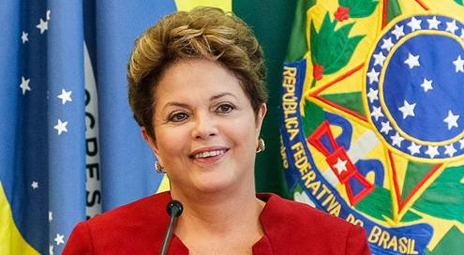
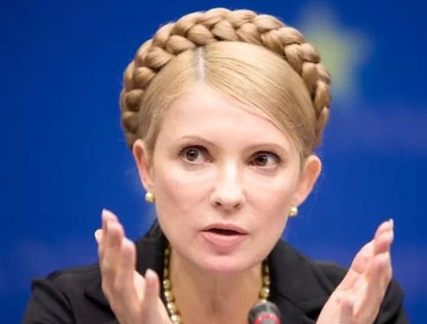
世界上最漂亮的十大女政客

Slide 5
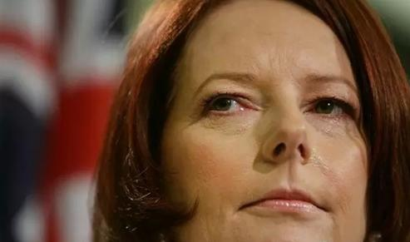
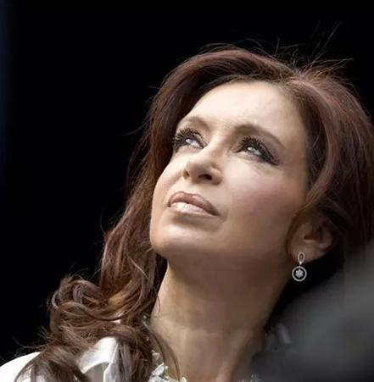
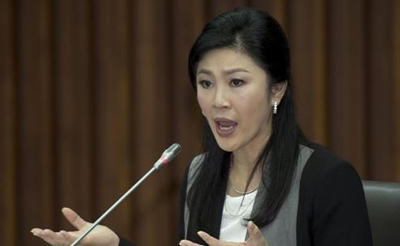
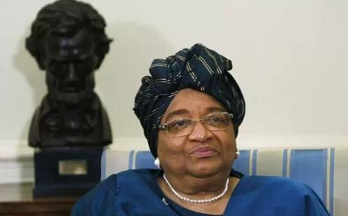
世界上最漂亮的十大女政客

Slide 6
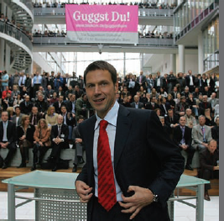
What is Workforce Diversity?
Workforce Diversity - the ways in which people in an organization are different from and similar to one another.

Slide 7
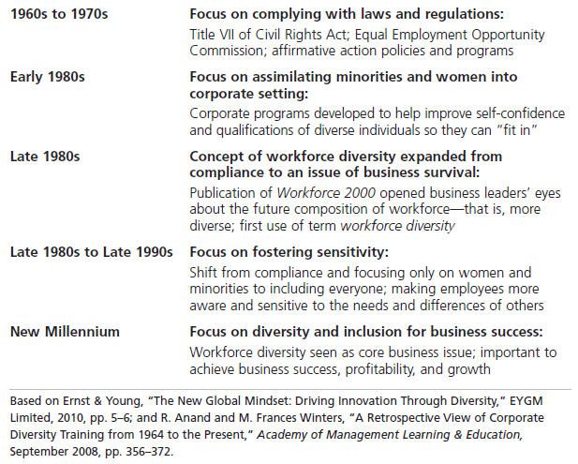
Exhibit 4-1: Timeline of the Evolution of Workforce Diversity

Slide 8
Levels of Diversity
Surface-level diversity-
Easily perceived differences that may trigger certain stereotypes, but do not necessarily reflect the ways people think or feel.
Deep-level diversity -
Differences in values, personality, and work preferences.

Slide 9
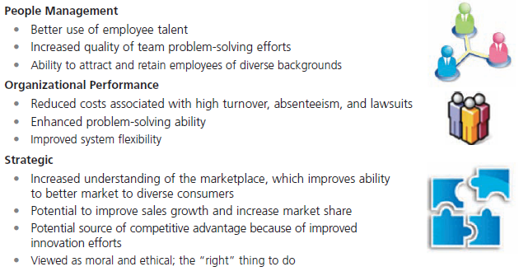
Exhibit 4-2: Benefits of Workforce Diversity

Slide 10
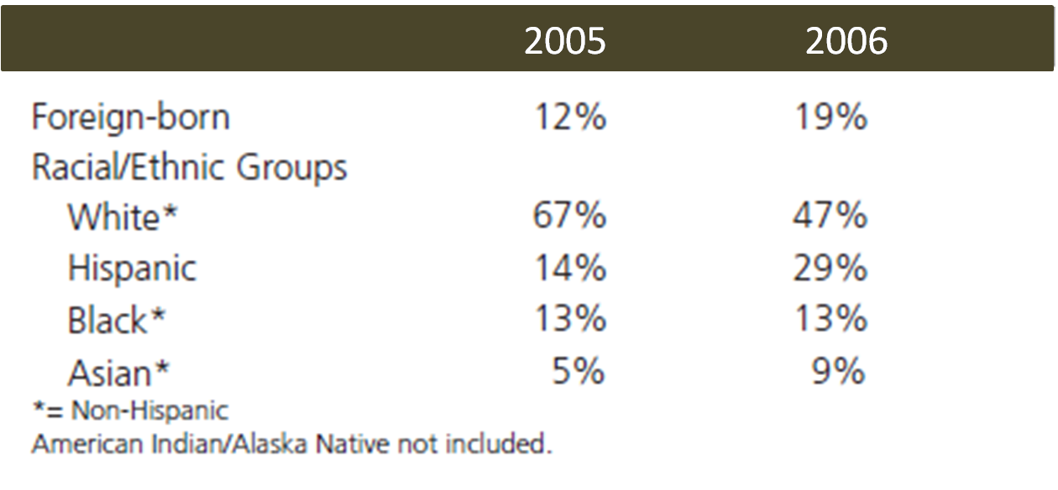
Exhibit 4-3: Changing Population Makeup of the United States

Slide 11
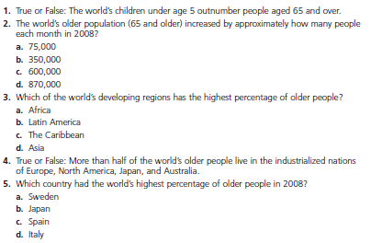
Exhibit 4-4: Global Aging: How Much do You Know?

Slide 12
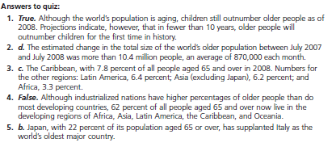
Exhibit 4-4: Global Aging (cont.)

Slide 13
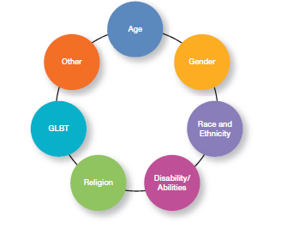
Exhibit 4-5: Types of Diversity Found in Workplaces

Slide 14
Types of Diversity
Age - Both Title VII of the Civil Rights Act of 1964 and the Age Discrimination in Employment Act of 1967 prohibit age discrimination.
Gender - Women (49.8%) and men (50.2%) now each make up almost half of the workforce.

Slide 15
Race and Ethnicity
Race - the biological heritage (including skin color and associated traits) that people use to identify themselves.
Ethnicity - social traits (such as cultural background or allegiance) that are shared by a human population.

Slide 16
Types of Diversity
Disability/Abilities - The Americans With Disabilities Act of 1990 prohibits discrimination against persons with disabilities.
Religion - Title VII of the Civil Rights Act prohibits discrimination on the basis of religion.
GLBT: Sexual Orientation and Gender Identity - U.S. federal law does not prohibit discrimination against employees on the basis of sexual orientation.

Slide 17
Challenges in Diversity (cont.)
Stereotyping - judging a person based on a prejudicial perception of a group to which that person belongs.
Discrimination - when someone acts out their prejudicial attitudes toward people who are the targets of their prejudice.
Glass Ceiling - the invisible barrier that separates women and minorities from top management positions.

Slide 18
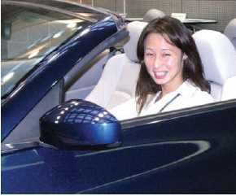
Challenges in Managing Diversity
Bias - a tendency or preference toward a particular perspective or ideology.
Prejudice - a pre-conceived belief, opinion, or judgment toward a person or a group of people.

Slide 19
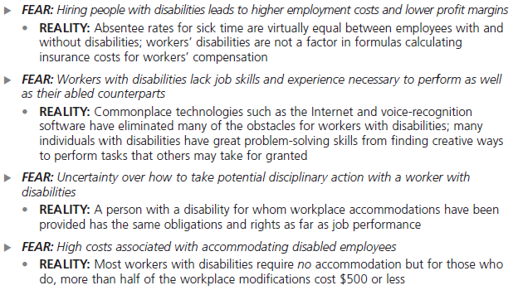
Exhibit 4-6: Employers’ Fears About Disabled Workers

Slide 20
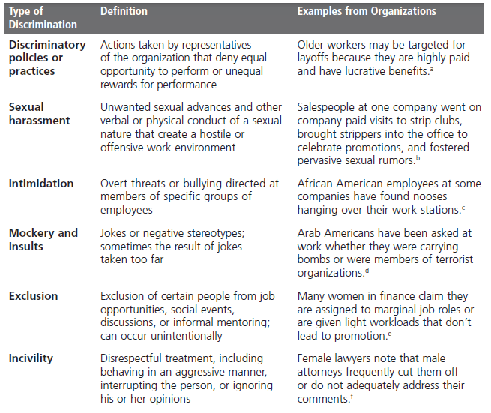
Exhibit 4-7: Forms of Discrimination

Slide 21
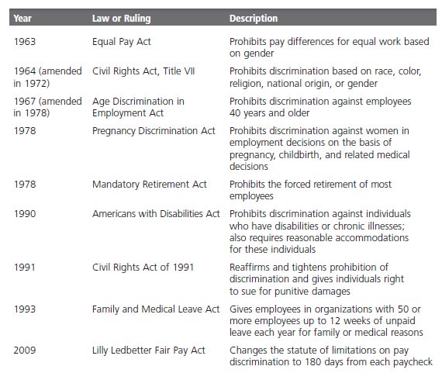
Exhibit 4-8: Major Equal Employment Opportunity Laws

Slide 22
Top Management Commitment to Diversity
Mentoring - a process whereby an experienced organizational member (a mentor) provides advice and guidance to a less-experienced member (a protégé).
Diversity Skills Training - specialized training to educate employees about the importance of diversity and to teach them skills for working in a diverse workplace.

Slide 23

Commitment to Diversity (cont.)
Employee Resource Groups - groups made up of employees connected by some common dimension of diversity.

Slide 24
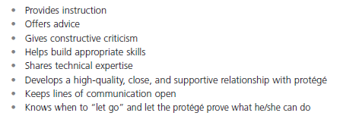
Exhibit 4-9: What a Good Mentor Does

Slide 25
Terms to Know
Workforce diversity
Surface-level diversity
Deep-level diversity
Race
Ethnicity
Bias
Prejudice
Stereotyping
Discrimination
Glass ceiling
Mentoring
Diversity Skills Training
Employee resource groups

